Slide 1
Introduction to Powder X-ray Diffraction
19th National School on Neutron and X-ray Scattering
Cora Lind-Kovacs
Department of Chemistry & Biochemistry
The University of Toledo, Toledo, OH

Slide 2
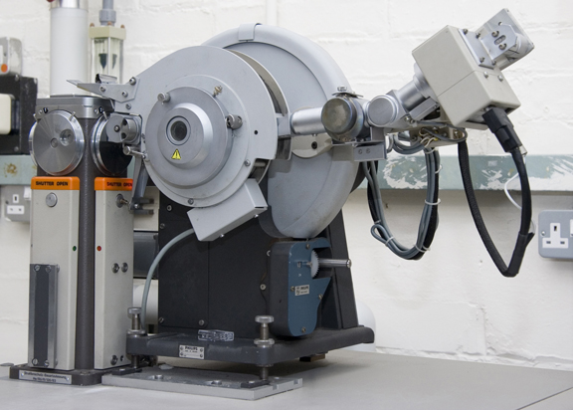
History of Powder Diffraction
Discovery of X-rays: Roentgen, 1895 (Nobel Prize 1901)
Diffraction of X-rays: von Laue, 1912 (Nobel Prize 1914)
Diffraction laws: Bragg & Bragg, 1912-1913 (Nobel Prize 1915)
Powder diffraction: Developed independently in two countries:
Debye and Scherrer in Germany, 1916
Hull in the United States, 1917
Original methods: Film based
First commercial diffractometer:
Philips, 1947 (PW1050)
Detectors and optics have improved a
lot, but basic design remains similar!
http://www.msm.cam.ac.uk/xray/images/pdiff3.jpg

Slide 3
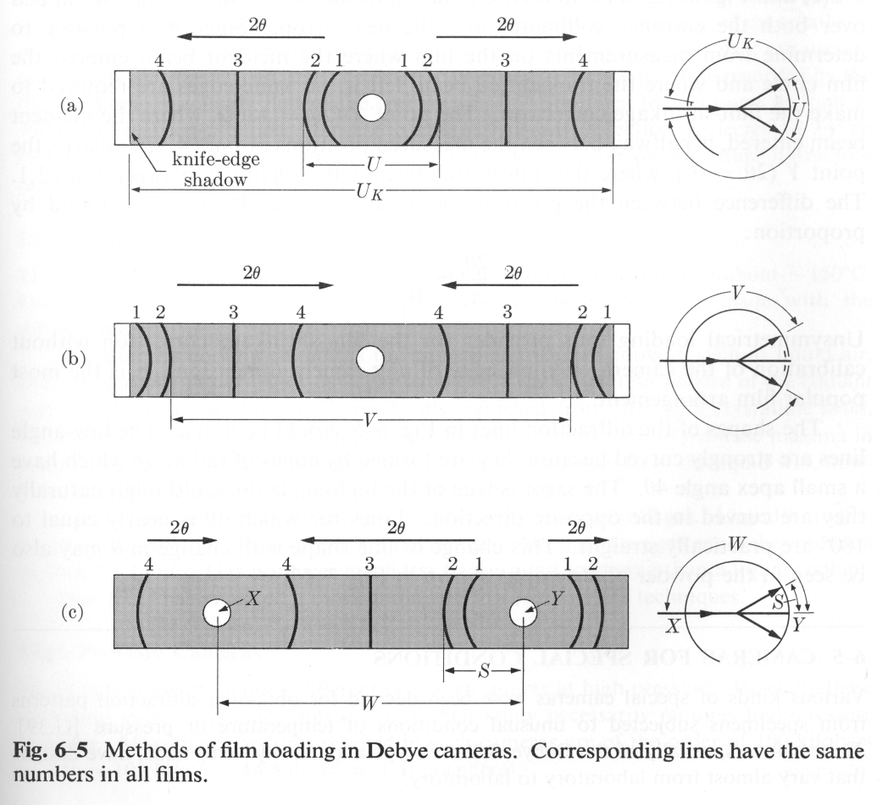
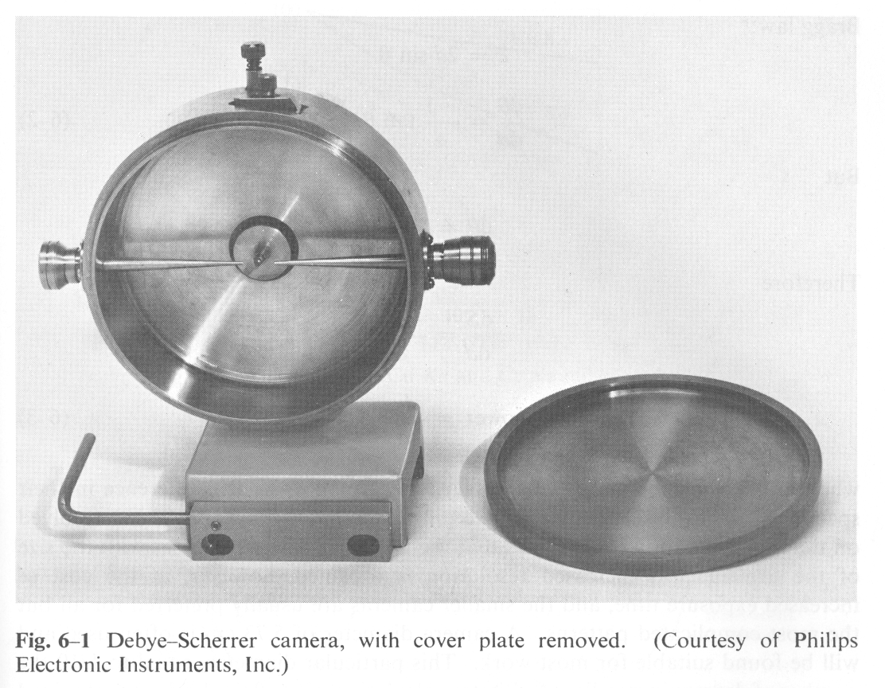
Original Powder Setups
Oldest method: Debye-Scherrer camera
Capillary sample surrounded by cylindrical film
Simple, cheap setup
Cullity; “Elements of X-ray Diffraction”

Slide 4
Physical Basis of Powder Diffraction
Powder diffraction obeys the same laws of physics as single crystal diffraction
Location of diffraction peaks is given by Bragg’s law
2d sinθ = nλ
Intensity of diffraction peaks is proportional to square of structure factor amplitude
. ·exp[-8π²⟨u²⟩(sin²(θ)/λ²]

Slide 5
Scattering of X-rays and Neutrons by Atoms
The structure factor equation contains a factor that describes the scattering power of atoms
Atomic scattering factor (form factor) f_{j} for X-rays
Depends on number of electrons in atom and Q (∝ sinθ/λ)
Undergoes large changes close to absorption edges
Scattering length b_{j} for neutrons
Depends on isotope, independent of Q
For some isotopes, b_{j} can be negative

Slide 6
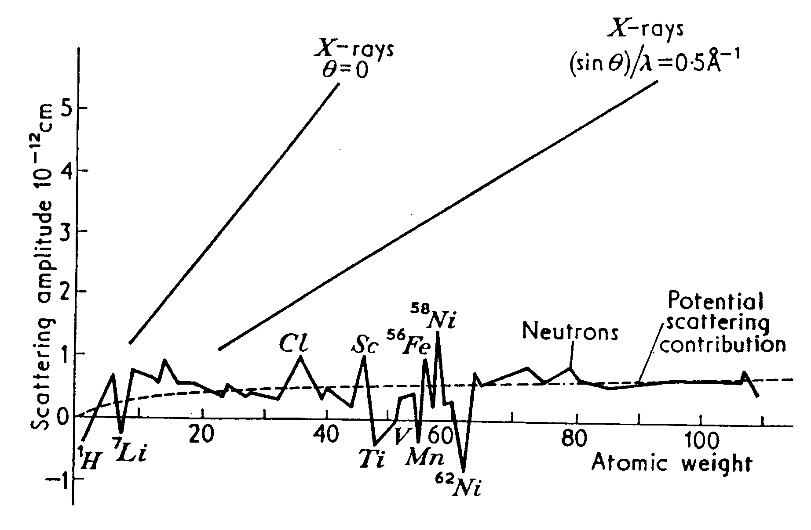
X-ray and Neutron Scattering Power

Slide 7
Resonant X-ray Scattering Experiments
Also referred to as “anomalous diffraction”; this type of experiment is carried out close to an absorption edge
The elastic scattering is given by
f (E,Q) = f_{o}(Q) + f_{o}’(E,Q) + I f_{o}’’(E,Q)
f ′ and f ′′ undergo drastic changes close to the absorption edges of atoms
Great way to emphasize contribution of specific atoms
Especially useful for mixed site occupancies
In most cases, multiple patterns at different wavelengths are collected and analyzed simultaneously

Slide 8
Absorption Edges and Anomalous Scattering
f ′′ “mirrors” the absorption coefficient
f ′ is intimately related to the absorption coefficient

Slide 9
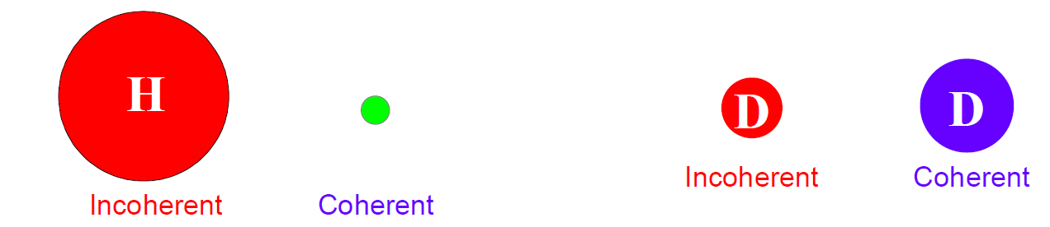
Neutrons: Coherent and Incoherent Scattering
For X-ray diffraction, we are generally only concerned with coherent elastic scattering
For neutron powder diffraction, we would like to only deal with coherent elastic scattering, but need to be aware of incoherent scattering as well
Phase is lost during incoherent scattering
Contributes to background
Less of an issue for single crystal experiments, but can be very significant for powder experiments
H is one of the worst culprits (not D!) – a few atom% can cause problems

Slide 10
Goal of crystallography: Get structure
Single crystal experiments
Grow crystals (often hardest step)
Collect data (usually easy, both access and setup)
Determine unit cell (very easy for good quality single crystal)
Reduce data and solve (=determine approximate structure) (often easy)
Optimize structure (=refinement) (requires some care)
Powder experiments
Prepare powder sample (often easy)
Collect data (usually easy, but easy to make mistakes, too!)
Determine unit cell (can be very hard)
“Solve structure” (can be even harder – requires expert knowledge!)
Optimize structure – Rietveld refinement (requires considerable care)

Slide 11
What is a Powder?
A perfect powder sample consists of an infinite number of small, randomly oriented crystallites
Note that this is the underlying definition for many quantitative analysis methods!
In real life, the number is of course not infinite, but should be large to give good averaging
Small particle size: 1-5 μm is ideal
“Powder samples” can come in many different forms:
Loose powders
Films, sheets, blocks, wires…
Basically any “polycrystalline” sample can be used in PXRD – if it is not a single crystal, it is considered a “powder sample”

Slide 12
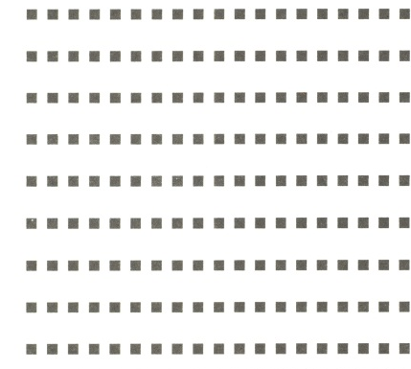
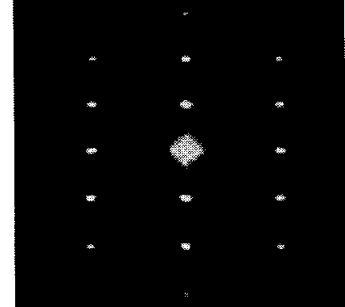
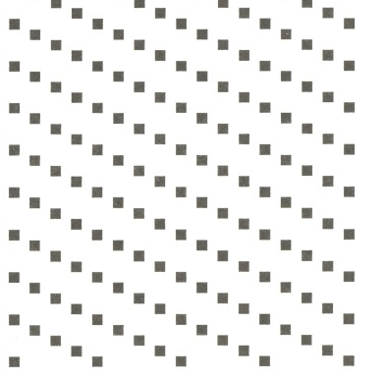

Observations from Single Crystals
For a single crystal, there is one orientation in real space, resulting in one orientation of the reciprocal lattice
reciprocal lattice points are resolved and will result in diffraction intensity when they touch the Ewald sphere
Rotating the crystal rotates the reciprocal lattice
Real space Reciprocal space
Real space Reciprocal space

Slide 13
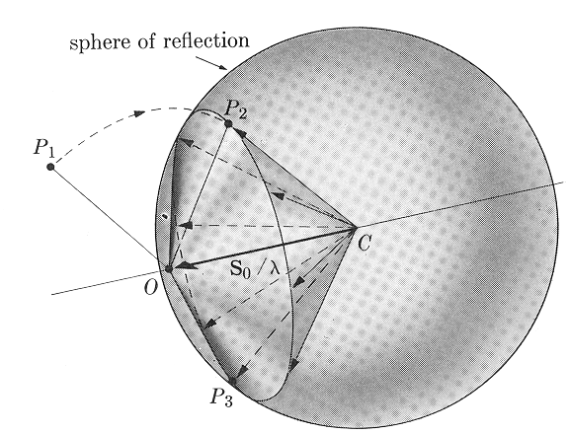
Observations from Powders
A powder sample consists of many crystallites with random orientations
we get many overlapping reciprocal lattices, resulting in a “sphere” of reciprocal lattice points that fulfill the Bragg condition at a given 2θ
the sphere will intersect the Ewald sphere in a circle
we will observe “powder rings”
Cullity; “Elements of X-ray Diffraction”

Slide 14
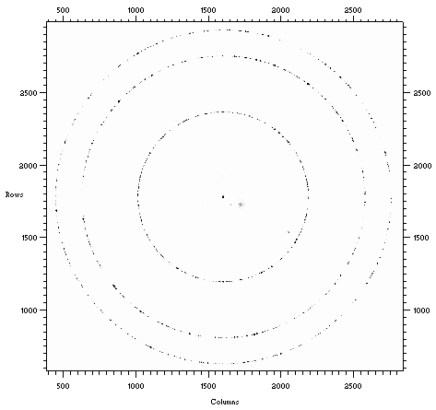
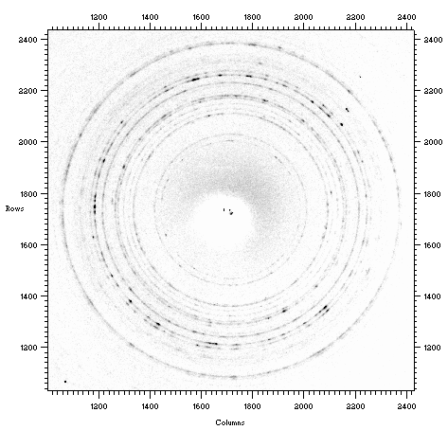
Somewhere in Between
Anything from “several single crystals” to “almost homogeneous” is possible!
Often referred to as “graininess problem” (e.g., not enough grains in the beam).
Can result in non-random integrated intensities.

Slide 15
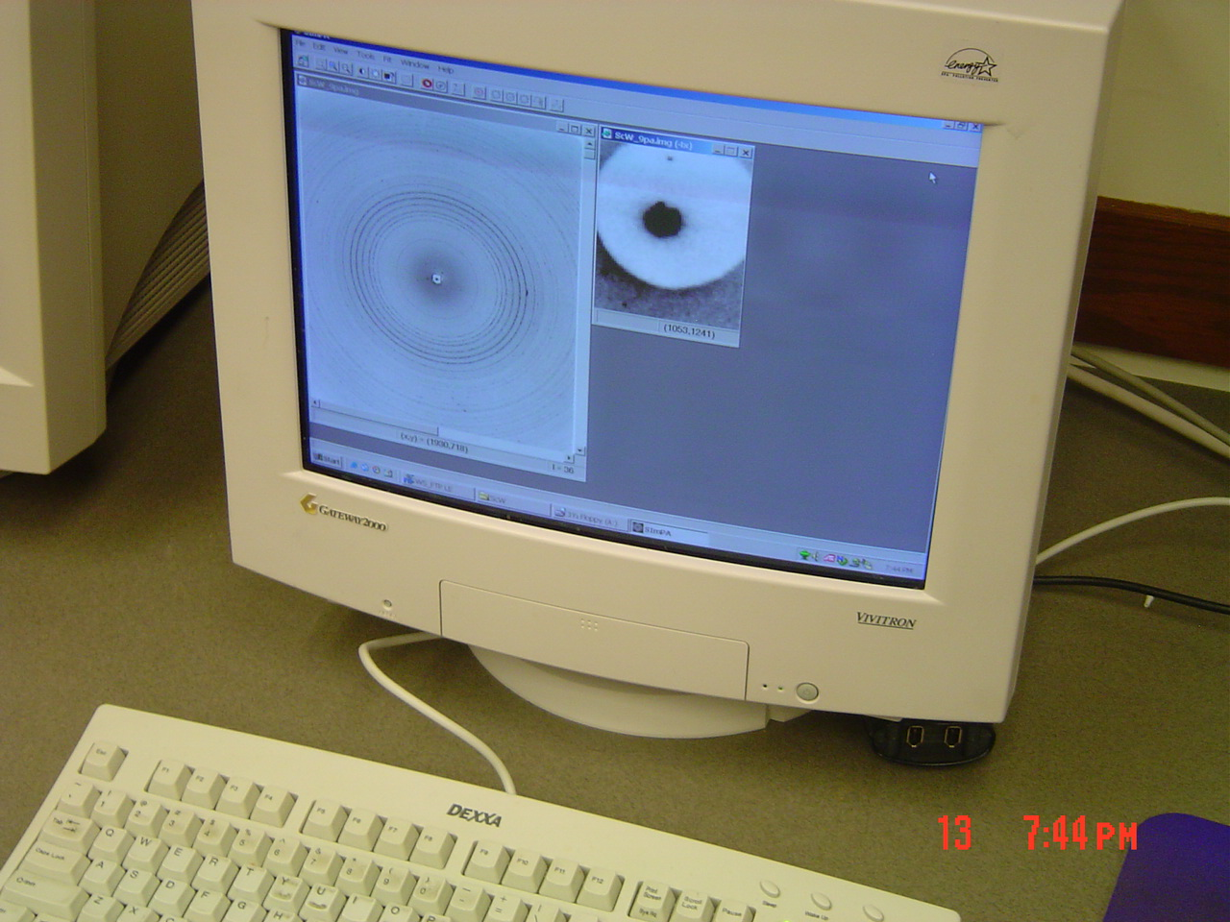
Powder Data Display
6000
5000
4000
3000
2000
1000
0
1
1.5
2
2.5
3
3.5
4
4.5
5
Q
Q = 4π sinθ / λ

Slide 16
Why Use Powder Diffraction?
Originally, powder diffraction was mainly used for phase identification
Advantages over single crystal methods: Can be used on ANY sample
If you can mount it, you can measure it!
For some materials, single crystal growth is difficult or impossible
Powder methods are the only option
“Real life samples” rarely come as single crystals: Engineering materials, formulations etc.
Powder diffraction can be used on mixtures of compounds
Peak shape analysis gives insights into size, stress and defects

Slide 17
Powder crystallography before Rietveld
Primary strategy: AVOID when it comes to structure determination!
There was no straightforward way to deal with data
Had to manually integrate intensities
Overlapping reflections were a big problem
Usually discarded
Alternative: Rewriting of single crystal software to refine using sums of overlapped reflections
Powder pattern simulation was more common
Relatively straightforward
Conclusions drawn based on similarities between patterns (e.g., isostructural compounds)
Visual comparison
Main use of powder diffraction was for phase identification

Slide 18
Modern Use: What Information Can We Get From Powder Diffraction Data?
Phase identification (qualitative phase analysis)
Most important/frequent use of PXRD
Qualitative analysis tool
Search pattern against database to identify phases present
Starting materials, known target compounds, likely impurities
Assumption: The material, or an isostructural material, is in the database
Phase fraction analysis (quantitative phase analysis)
Applied to mixtures of two or more crystalline phases
Compare intensities of selected peaks of all phases
Theoretically only requires one peak/phase, but better with multiple peaks
Accurate analysis requires standardization
Mix known quantities of two phases in several different ratios
Caution: Possibility of amorphous components

Slide 19
What Information Can We Get From Powder Diffraction Data? (Cont’d)
Lattice parameters
Two modes of analysis:
Accurate lattice parameters for a compound of known structure
Unit cell determination for an unknown compound through indexing
ACCURATE peak positions are crucial!
Rietveld refinement (structural analysis)
Least squares based minimization algorithm to obtain the best fit between a structural model and a powder pattern
Starting model necessary to apply this method
Applicable to simple and complicated structures, single phase and multi-phase samples
Automatically gives phase fractions and lattice parameters from ALL peaks
Requires good data for meaningful results

Slide 20
What Information Can We Get From Powder Diffraction Data? (Cont’d)
Structure Determination from Powder Data (SDPD)
Powder diffraction is subject to the same laws of physics as single crystal diffraction, but data overlap
Careful analysis can allow determination of unknown structures
Usually done with high quality synchrotron and/or neutron data
Requires excellent data and sound crystallographic knowledge!
Phase transition behavior
In situ diffraction experiments
Temperature-induced phase transitions
Pressure-induced phase transitions
Kinetic studies
Requires specialized setups

Slide 21
What Information Can We Get From Powder Diffraction Data? (Cont’d)
Line shape analysis
Width of Bragg peaks is inversely related to crystallite size
Often used for crystallite size estimates for nanoparticles
Requires use of a standard to determine instrument contribution first
Microstrain (nonuniform strain) also results in peak broadening
Due to atomic disorder, dislocations, vacancies etc.
Different angular dependence than size effects
Residual stress can be determined
Defects like stacking faults and antiphase boundaries also affect line shape
Texture analysis
Epitaxial growth in thin films
Preferred orientation
Qualitative and quantitative measurements possible

Slide 22
Extracting Information from the Diffractogram
All diffractograms contain three pieces of information:
Peak positions
Peak intensities
Peak shapes
Each of these can be used to extract qualitative or quantitative information from the data
Single crystal experiments are only concerned with peak positions and intensities, whereas powder diffraction also analyzes peak shapes to extract microstructural information from samples
Often not important to get crystal structure, but can be crucial to understand behavior of “real life materials”!

Slide 23
Peak Positions
Peak positions can be used to obtain the following pieces of information:
Unit cell dimensions
d-spacing is related to unit cell constants
Could be a refinement of a know starting cell or a determination “from scratch” by indexing
Possible space groups
Look at systematic absences – “no peak” is information, too!
Qualitative phase analysis
What’s in the sample?
Approximate peak positions sometimes suffice for this

Slide 24
Standards
A standard can be used to check the alignment of a diffractometer
Many different materials commercially available
SiO₂, Si, CeO₂, Al₂O₃…
Sold through independent vendors (e.g., NIST) or provided by diffractometer company
Easiest to use standards come as pressed solids
Sample height is predefined this way
Experimentally determine peak positions of the standard, then compare to certified values to construct a calibration curve
Allows for correction of data collected under same conditions

Slide 25
Internal Standards
A standard can also be mixed with your powder sample
Called internal standard
You can use any material that is available as a powder and has well-established lattice constants
If you are planning to refine a model for your data, a model for your internal standard can be refined at the same time
Constrain standard to known lattice constants, refine sources of peak position errors, which also apply to your sample
Choose a standard with similar absorption properties as your sample
This allows you to account best for ALL sources of error
E.g., sample transparency, absorption

Slide 26
Peak Intensities
Peak intensities contain information about the following:
Positions and types of atoms
Site occupancy of atoms
Atomic displacement parameters
Often referred to as “temperature factors”
Accurate intensities are necessary for:
Quantitative phase analysis
Rietveld (structural) refinement
Structure solution from powder data
Use integrated peak intensities to eliminate line broadening effects!
Experimental setup also influences peak intensities
Lorentz-Polarization factor, absorption…
So does the sample itself

Slide 27
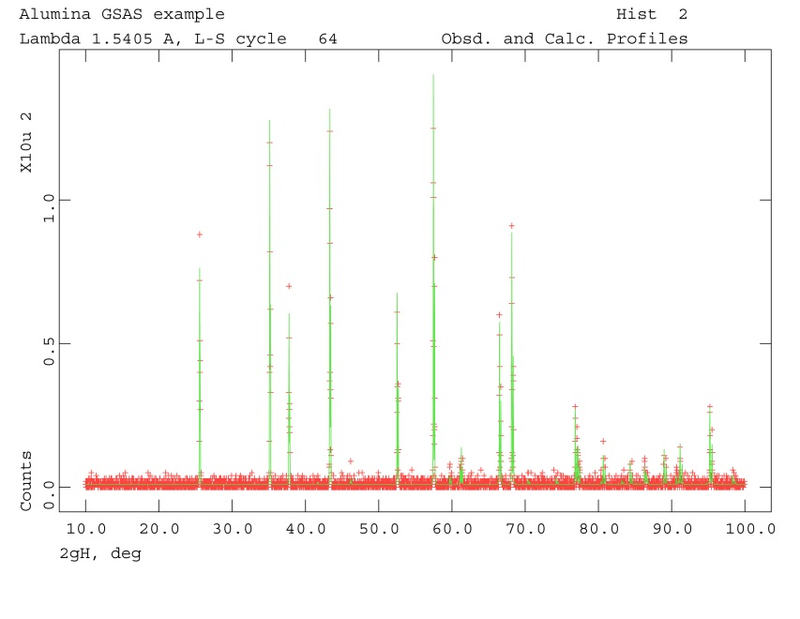
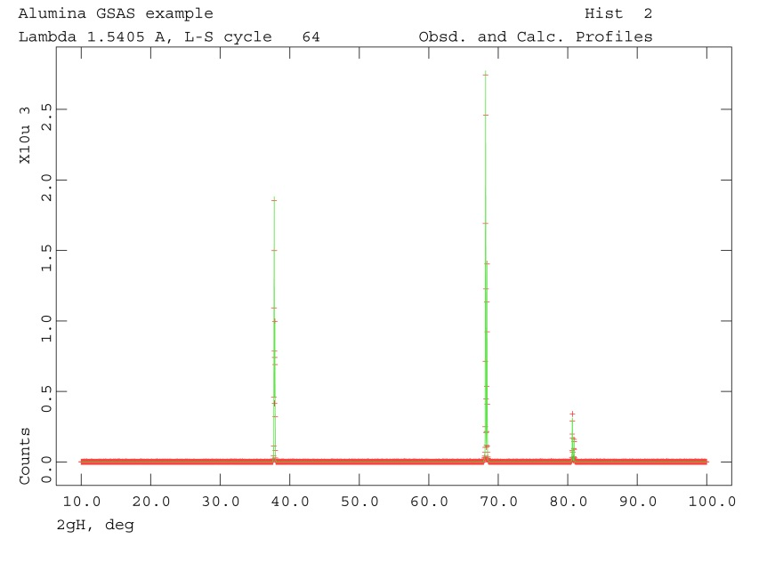
Preferred Orientation
Some samples do not show random intensities
Some orientations are over- or underrepresented
In severe cases, only some lines are observed, others are absent
Preferred orientation can be desired
E.g., epitaxial film
Generally problematic and undesirable for powder data analysis

Slide 28

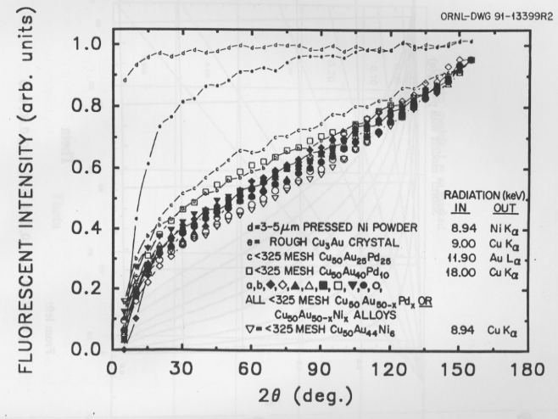
Surface Roughness Effects (Microabsorption Problem)
http://www.osti.gov/bridge/servlets/purl/5062229-1CKCM6/5062229.PDF
Notes:
325 mesh = < 44 micron

Slide 29
Peak Shapes
Peak shapes are affected by the following:
Crystallite size
Significant effects for cystallites below 100 nm
Microstrain
Microstrain can lead to a “range” of lattice parameters due to strain
Ordered defects
Stacking faults, antiphase boundaries
Instrument
Finite source size
Axial divergence
Slits
Detector resolution
Isotropic or anisotropic peak broadening can result
For quantitative analysis, a standard with no crystallite size or strain broadening must be used to determine the instrumental contribution

Slide 30
Examples of Peak Shapes
Notes:
True Voigt: Convolution of G and L, but messy math, slow computing. Thus generally a PV is used. Works pretty well.

Slide 31
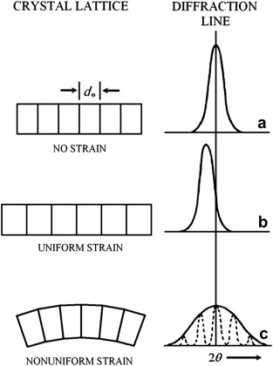
Sample Related Peak Broadening
Crystallite size:
Diffraction from an infinite crystal would give infinitely sharp peaks (delta function)
Finite repeat leads to broadening
Can be used to calculate crystallite size (Scherrer equation), B = FWHM in radians
For lab instrument: B_{size} = 0.9 λ/(t cos(θ))
Instrument broadening must be accounted for to get meaningful, qualitative results!
B²_{measured} = B²_{instrument} + B²_{size}
Strain broadening:
Results in distribution of lattice constants
More shift at higher angles – proportional to tan(θ)
Both effects can be isotropic or anisotropic!
Anisotropic effects are generally hkl dependent
Notes:
B in radians; t is crystallite size

Slide 32
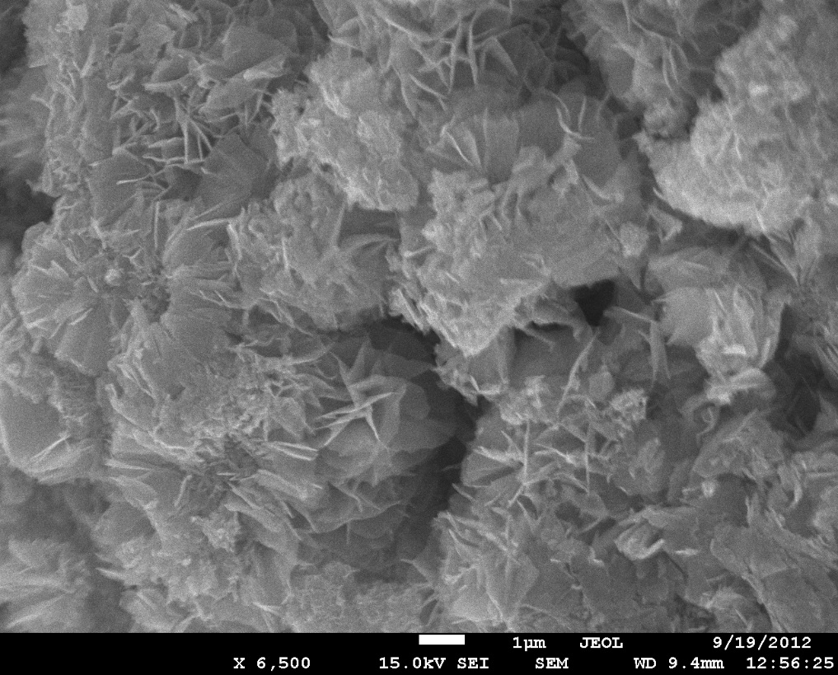
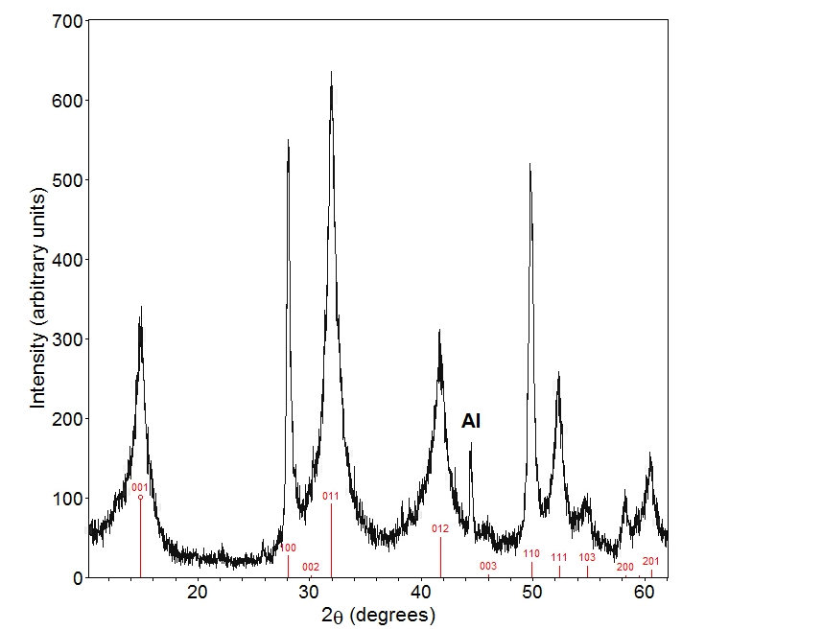
Sample related peak broadening
Notes:
B in radians; t is crystallite size

Slide 33
Powder Diffraction Detector Options
Powder X-ray diffraction can use 1D or 2D detectors
Area (2D) detectors allow for very fast data collection
On high intensity synchrotron beamlines, a dataset can be collected in a fraction of a second!
Tradeoff with respect to resolution
Often used for parametric studies when speed of data collection is most important
Point detectors (1D) allow for very high resolution data
A single crystal analyzer can be mounted between the sample and the detector
Data collection speed can be improved by using multiple detectors
Example: 11-BM high resolution diffractometer at APS

Slide 34
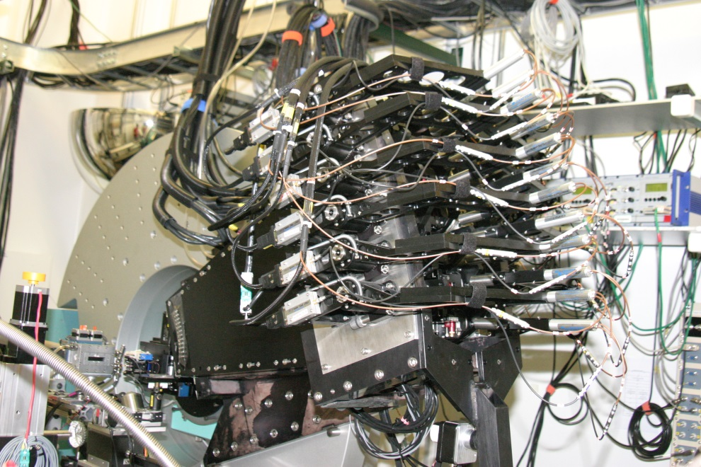
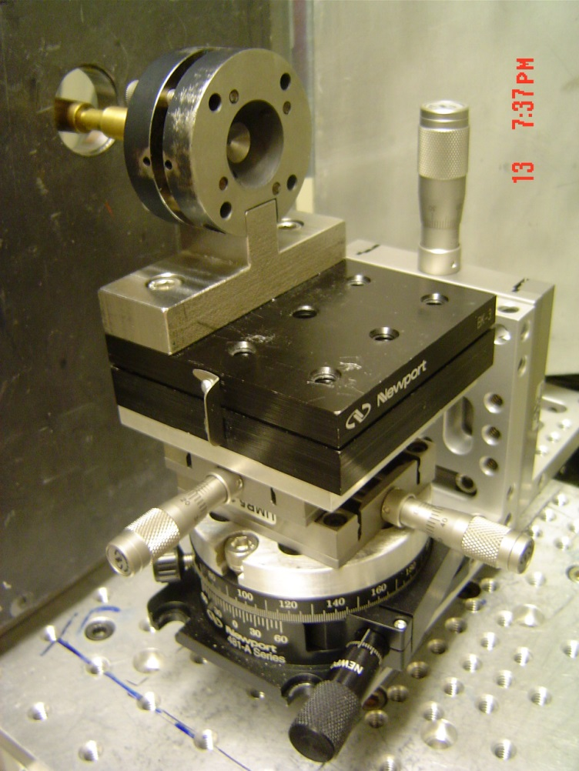
Powder Diffraction Detector Options
2D detector (CHESS B2) and 1D detector array (APS 11-BM)

Slide 35
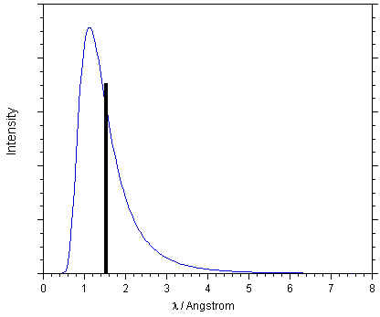
Reactor Sources
Experimental setup very similar to lab X-ray diffraction
Large samples needed
low intensity beams
No form factor fall-off gives good quality data at small d-spacings
but d_{min} is often similar to a lab X-ray experiment
Typical monochromator cut at ~1.5 Å for T = 300 K

Slide 36
Spallation Source – TOF Experiments
Neutrons are particles with mass, so wavelength and speed are correlated (de Broglie)
Data are plotted as a function of t (TOF)
Detectors are combined in “banks” at fixed angles
Each detector bank collects an entire diffraction pattern
Accessible d-spacing range depends on angle of bank
with
so
Notes:
L: 9-100m, L1: 1-2m

Slide 37
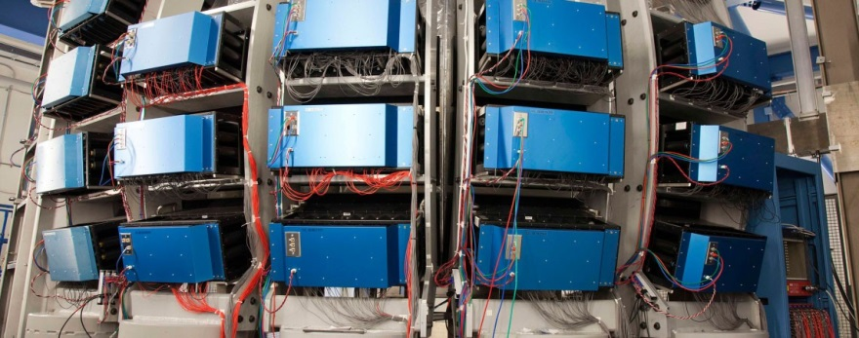
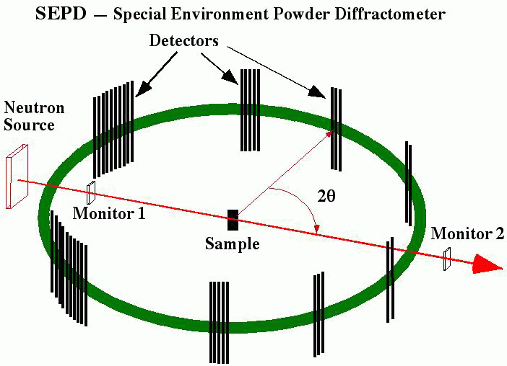
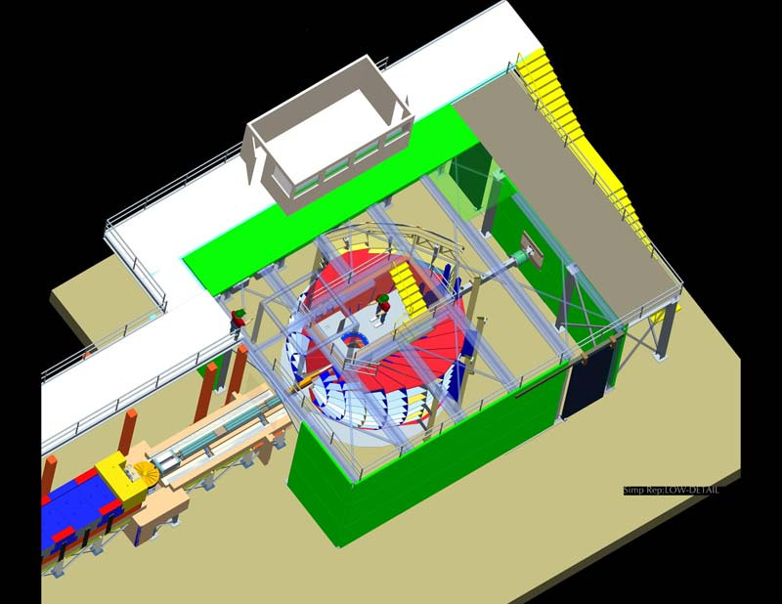
Neutron Instruments
Earlier TOF neutron instruments at IPNS (SEPD), and modern instruments at SNS (POWGEN)
POWGEN
Notes:
L: 9-100m, L1: 1-2m

Slide 38
Powder Pattern Analysis Beyond Search/Match
As stated previously, early use of powder methods, and most common use today, was for phase ID
1966-1969: Hugo Rietveld* introduced a whole pattern fitting approach for neutron data
Nowadays known as “Rietveld method”
Soon applied to X-ray data (1977)
Became more feasible with increasing computer power
“Routine” powder tool by now
The Rietveld method can be used to verify structures, determine accurate lattice parameters, microstructural sample characteristics, phase fractions in mixtures etc.
*It is with great sadness that we acknowledge the passing of Hugo Rietveld on July 16, 2016.

Slide 39
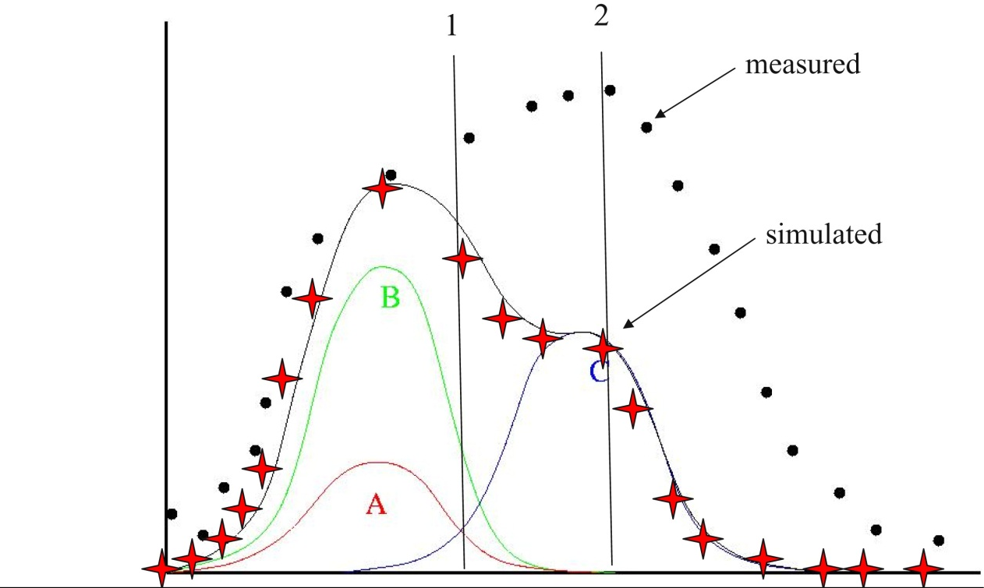
Major Breakthrough: Overlapped Reflections
Rietveld witnessed the power of introducing computers into crystallography during his dissertation (1961-1964)
He realized that computers can handle individual datapoint intensities, which allowed calculation of |F_{hkl}| even for overlapped reflection!

Slide 40
What is the Rietveld Method?
Least squares based minimization algorithm to obtain the best fit between a structural model and a powder pattern
Demanding, as the algorithm is non-linear
User decides which parts of the model can be varied
Each point in the pattern can be regarded as an observation
“No Bragg intensity” tells you something about your material, too!
Full pattern fitting
In contrast to single crystal data, “experiment dependent parameters” must be fitted as well: Background, peak shape – sample and instrument contributions, lattice constants, …
Requires an approximate starting model
Good data are needed!

Slide 41
Parameters in Rietveld Refinements
Structural variables
Atom positions, fractional occupancies, atomic displacement parameters (ADPs)
Only these parameters are refinable in most single crystal software
Profile parameters
Background
Peak shape, including width and asymmetry
Unit cell constants
Wavelength
Diffractometer zero point
Sample height and transparency
Correction terms
Absorption
Extinction
Surface roughness
Preferred orientation

Slide 42
Possibilities
Works for simple and complicated structures
Thanks to today’s computing power, fast even for complicated structures
Can be used to refine several phases as well as mixed occupancies
Use of internal standard possible – excellent lattice constants!
Quantitative analysis of mixture or versus a standard (amorphous content, too)
Non-stoichiometry/partial occupancy can be refined
Refinement of several data sets together
X-ray and neutron data
Several different wavelengths => changes scattering contrast between atoms
Engineering properties
Residual strain
Preferred orientation

Slide 43
Limitations
Determination of absolute structure from powder data is impossible due to precise overlap of hkl and -h-k-l reflections
Parameters can sometimes be correlated
For limited data, constraints or restraints can be necessary
Restrain bond distances or bond angles
Constrain composition if known
The method only works if you have a good starting model!
Otherwise, divergence might be observed
A local instead of a global minimum may be found
YOU need to judge the refinement – no simple rules of thumb for R-values etc. or cif file and checkcif!

Slide 44
Useful Resources
CCP14: Free software including tutorials and examples http://www.ccp14.ac.uk/
Unfortunately no longer maintained due to lack of funding
Rietveld mailing list
http://www.mail-archive.com/rietveld_l@ill.fr/
Not sure whether this website is accessible from here?
GSAS tutorials http://www.aps.anl.gov/Xray_Science_Division/Powder_Diffraction_Crystallography/
Scroll down to “Software tutorials”
R. A. Young; “The Rietveld method”
Comprehensive text including history, description of several Rietveld programs, as well as details about certain parameters (e.g. background modeling, peak shapes, pattern decomposition…)
…and many more good books!

